Slide 1


1
TEST PLANNING

Slide 2
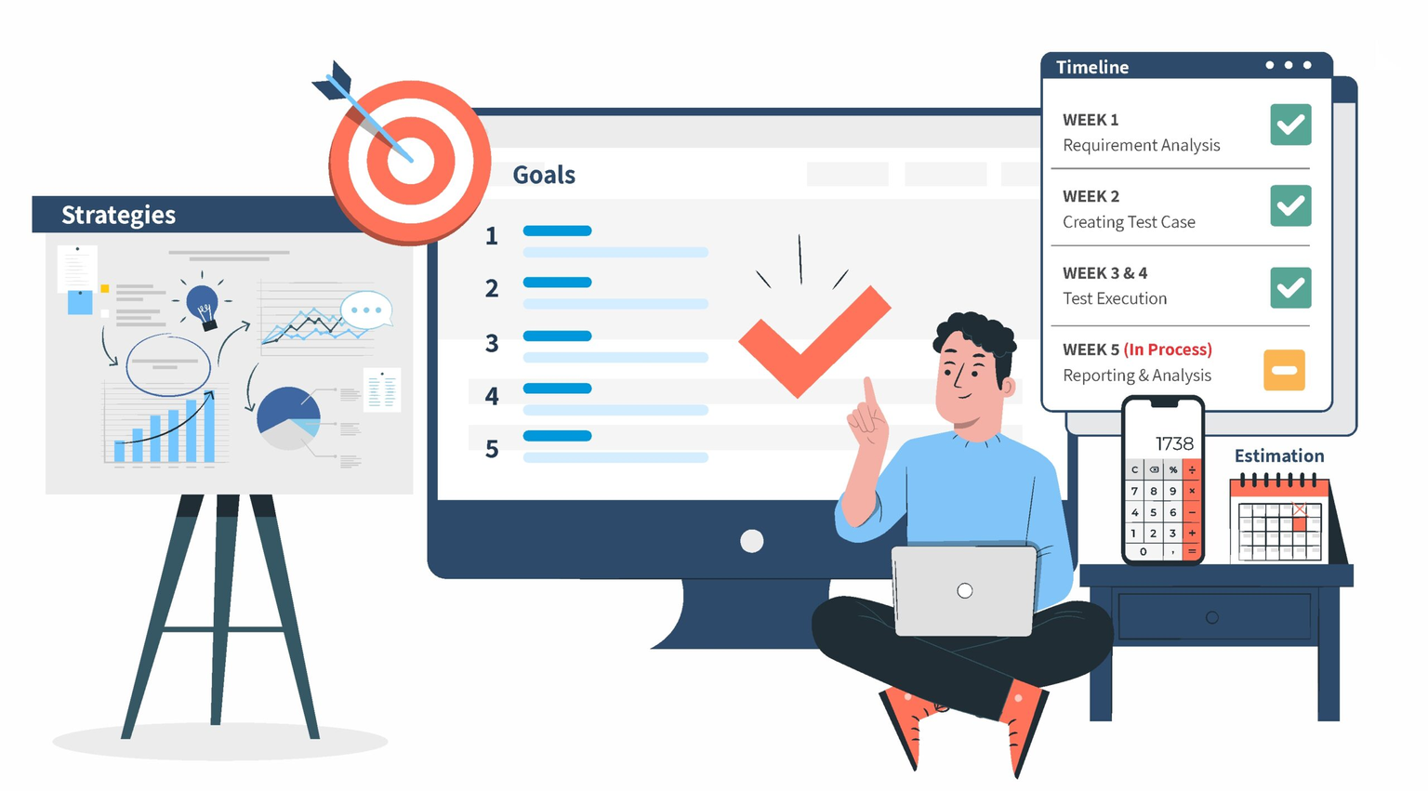
2
What is a Test Plan?

Slide 3

Why it is important?
3
Defines Objectives
Resource Allocation
Focus on Priorities
Avoids Scope Creep
Mitigate risks
Stakeholder Alignment

Slide 4
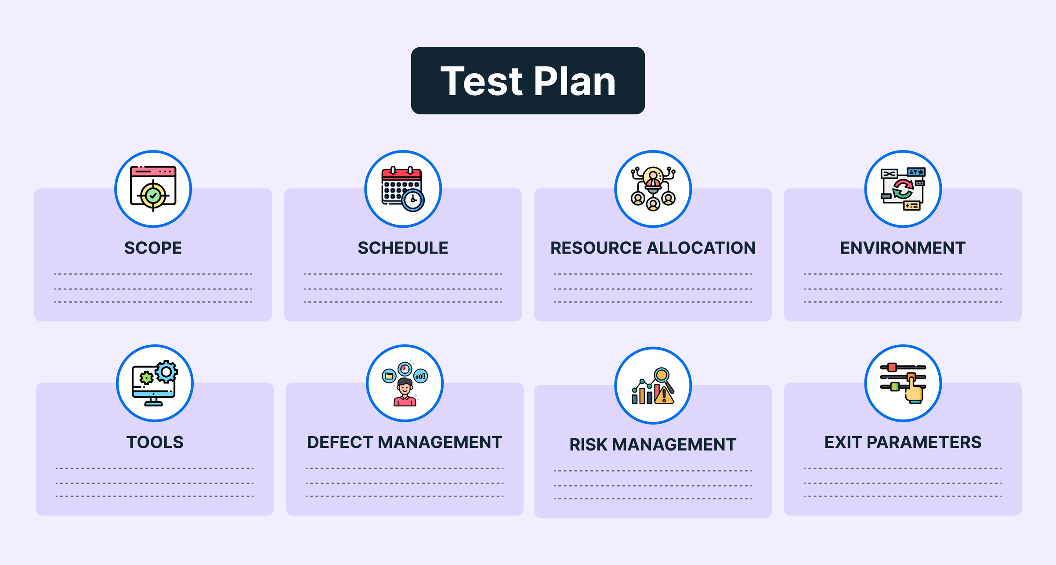
4
Components of a Test Plan

Slide 5

5
Advantages
Disdvantages
Consistency
Quality Assurance
Cost Efficiency
Client Satisfaction
Time Management
Time-Consuming
Can Limit Flexibility
Potentially Over-Detailed

Slide 6

6
Test Management Tools
JIRA
HP ALM (Application Lifecycle Management)
TestRail
qTest
Zephyr

Slide 7
7
TEST PLAN FOR AMAZON'S "ONE-CLICK PURCHASE" FEATURE
Objective
Ensure the "One-Click Purchase" feature functions correctly across all platforms (web, mobile, and app).
Verify the security of payment processing and user information.
Confirm that the feature integrates smoothly with existing systems, such as the shopping cart, inventory, and payment gateways.
Measure performance under high user load to prepare for peak shopping seasons.
2. Scope of Testing:
Functional Testing
Compatibility Testing
Security Testing
3. Roles and Responsibilities
Performance Testing
Usability Testing

Slide 8
8
4. Testing Environment
Web and Mobile Environments:
Simulated Load Environments:
5. Risk Analysis
Risk - The feature may not perform well during high traffic.
Risk - Security vulnerability could compromise user payment data.
Risk - The feature may be incompatible with certain devices or OS versions
6. Exit Criteria:
No critical issues; passes all tests for functionality, performance, and security.

Slide 9
THANK YOU

